Slide 1
RFM Segmentation Overview
Calculating RFM Logic and RFM Scores Using percentiles based on Recency, Order Count, and Profit.
Creating RFM Table and Connecting to RFM Segment Table Relationship established through Customer Key.
Customer Segmentation into Six Groups Based on RFM Scores:
Champion
Loyal Customers
Need Attention
Potential Loyalist
About to Sleep
Promising Customers
Total Number of Customers in Each Segment
Breakdown of Customers Segment: Showing Customer Name, Country, Revenue, Profit, Recency. Also includes total Revenue, Profit, and Customer Count for segment.

Slide 2
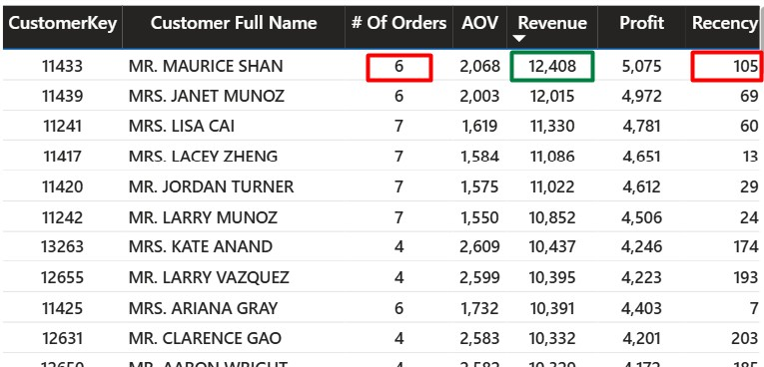
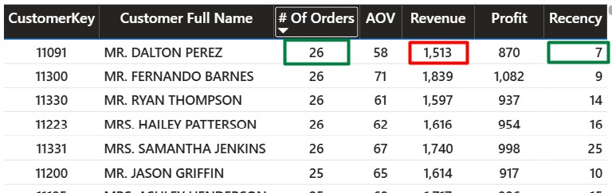
From the table, Mr. Dalton Perez has placed a higher number of orders (26) compared to Mr. Maurice Sen. However, in terms of revenue and profit, Dalton Perez is behind Maurice. Dalton’s total revenue is 1,570 and profit is 870, which are both lower than Maurice Sen’s revenue of 12,408.
Although Maurice Sen has a high recency value of 105—meaning he made his last purchase around 3.5 months ago—he remains a valuable customer due to the high revenue he has generated.
Based on his high number of orders and recent activity, Mr. Dalton Perez is a customer worth paying attention to.
So, analyzing each metric separately — like only looking at order count or revenue — can create confusion. For example, Dalton Perez has the highest number of orders, while Maurice Sen generated the highest revenue. One might be a concerned customer due to recent activity, and the other a valuable customer due to high spending. Without combining all metrics, it's hard to identify both valuable and concerned customers properly.

Slide 3
So instead of analyzing each metric separately,
RFM segmentation allows us to compare multiple metrics like recency, frequency, and monetary value together —
making customer analysis more efficient.
An RFM table is being created based on order, profit, and revenue to segment these customers more effectively

Slide 4
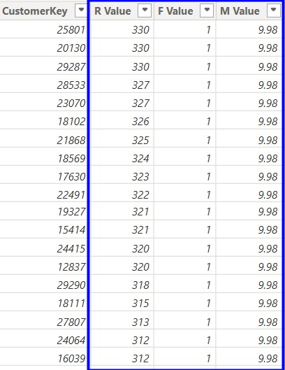
Recency, Frequency, Monetary Value
In the RFM table, three key factors are considered to calculate RFM values:
Recency (R): How recent each purchase was
Frequency (F): How often the customer makes purchases
Monetary (M): How much the customer spends
RFM Table =
SUMMARIZE(
FactSales,
FactSales[CustomerKey],
"R Value", [Recency],
"F Value", [# Of Orders],
"M Value", [Revenue])

Slide 5
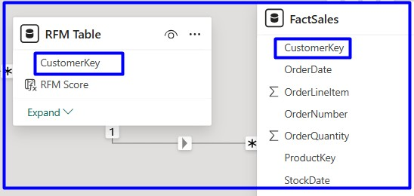
Modelling :Rfm Table With Fact Sales
After calculating the RFM values, a relationship was created between the FactSales table and the RFM Table using the Customer Key. This connection is necessary because Customer Key is the common field that links customer transaction data in FactSales with the segmented RFM data, allowing us to analyze customer behavior across both tables.

Slide 6
RFM SCORES & Percentile
RFM scores refer to the ranked or scored version of those values (usually on a scale of 1 to 5), based on percentiles or quantiles
To calculate RFM Scores, the data needs to be divided into five equal parts. For this, percentiles are used to determine the cutoff points.
The 20th percentile refers to a value below which 20% of the data falls, and above which 80% of the data lies. This helps in segmenting customers based on how recently they made a purchase, with more recent activity considered more favorable.
A cutoff point is a specific value that divides your data into groups — for example, to separate top 20% customers from the rest based on sales, orders, or recency

Slide 7
RFM Score: Explanation and Calculation
In the case of Recency (R), the 20th percentile is assigned the highest score of 5, because lower recency (more recent purchases) is better for the business. Following that logic, the 40th, 60th, and 80th percentiles are assigned scores of 4, 3, and 2 respectively, and the rest (above the 80th percentile) receive a score of 1.
R Score =
SWITCH(
TRUE(),
[R Value] <= PERCENTILE.INC('RFM Table'[R Value], 0.20), 5,
[R Value] <= PERCENTILE.INC('RFM Table'[R Value], 0.40), 4,
[R Value] <= PERCENTILE.INC('RFM Table'[R Value], 0.60), 3,
[R Value] <= PERCENTILE.INC('RFM Table'[R Value], 0.80), 2,
1)

Slide 8
For Frequency (F), customers who have placed orders more frequently (i.e., have higher order counts) are more valuable to the business. Therefore, those above the 80th percentile—meaning they have ordered more frequently than 80% of customers—are assigned the highest score of 5. Customers with lower order frequencies fall into lower percentile ranges and receive lower scores accordingly.
The same logic applies to the Monetary (M) value. Customers who generate higher revenue or profit are better for the business. So, those above the 80th percentile in spending are assigned a score of 5, and lower-spending customers receive proportionally lower scores based on the percentile they fall into.

Slide 9

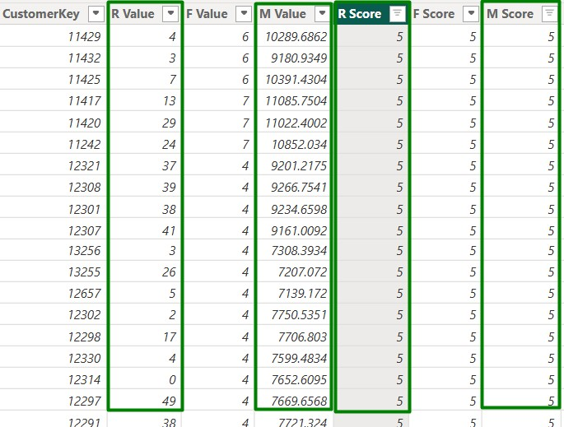
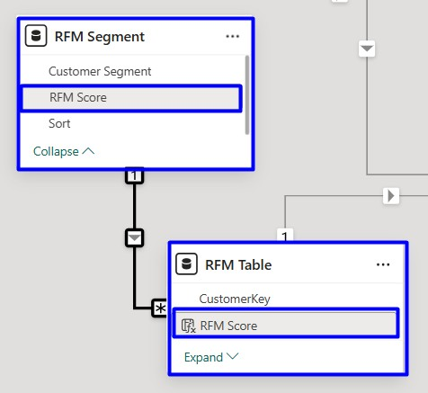

New columns were added as R Score, F Score, and M Score. According to the M Score of 5, the corresponding customers show the highest revenue values — such as 10,289, 9,180, and 10,391. Similarly, for an R Score of 5, the R values show the lowest recency — like 4, 13, 7, and 13 — indicating these customers purchased most recently. Likewise, an F Score of 5 is assigned to customers with the highest number of orders, such as 26 and 25.

Slide 10
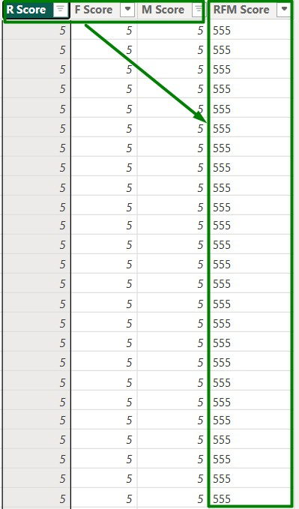
After calculating the RFM scores separately, a new column called 'RFM Score' was created by concatenating the R Score, F Score, and M Score.
RFM Score =
'RFM Table'[R Score] & 'RFM Table'[F Score] & 'RFM Table'[M Score]

Slide 11
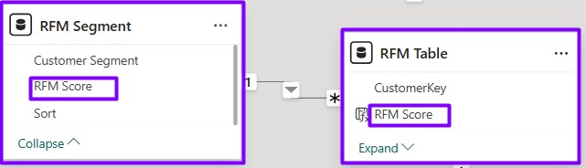
Modeling: Connecting RFM Table with RFM Segments
The RFM segment was connected to the RFM score from the RFM table so that the customer segment information aligns properly with the corresponding RFM scores. This ensures that each customer's segment is accurately linked to their RFM score for better analysis.

Slide 12
Modeling: Connecting RFM Table with RFM Segments
The RFM segment was connected to the RFM score from the RFM table so that the customer segment information aligns properly with the corresponding RFM scores. This ensures that each customer's segment is accurately linked to their RFM score for better analysis.

Slide 13
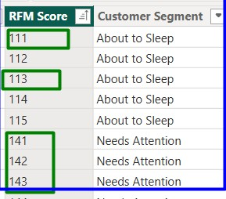
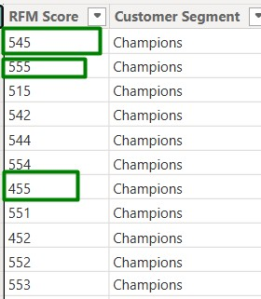
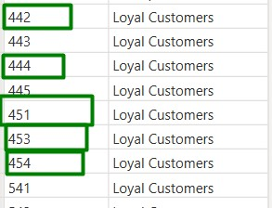
Customers with RFM scores like 555, 544, and 455 are categorized as 'Champions' because they have high order frequency, recent activity, and high revenue — making them the most valuable. Customers with scores like 442, 441, 451, and 454 are considered 'Loyal Customers' — they purchase regularly and contribute consistent revenue, even if they’re not the most recent buyers. Scores like 111, 112, and 113 fall into the 'About to Sleep' segment — these customers haven’t purchased recently, and both their order frequency and spending are low. Finally, customers with scores like 141, 142, and 143 are labeled as 'Need Attention' — they have decent order and monetary value, but their recent activity is low, meaning they may be losing interest and need to be re-engaged.

Slide 14
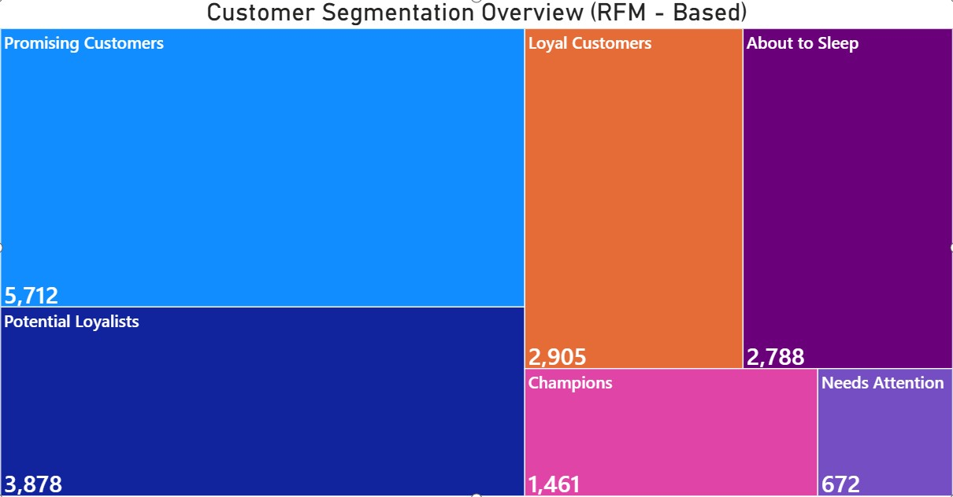
Total Customer By Recenecy,Frequency & Monitary Value

Slide 15
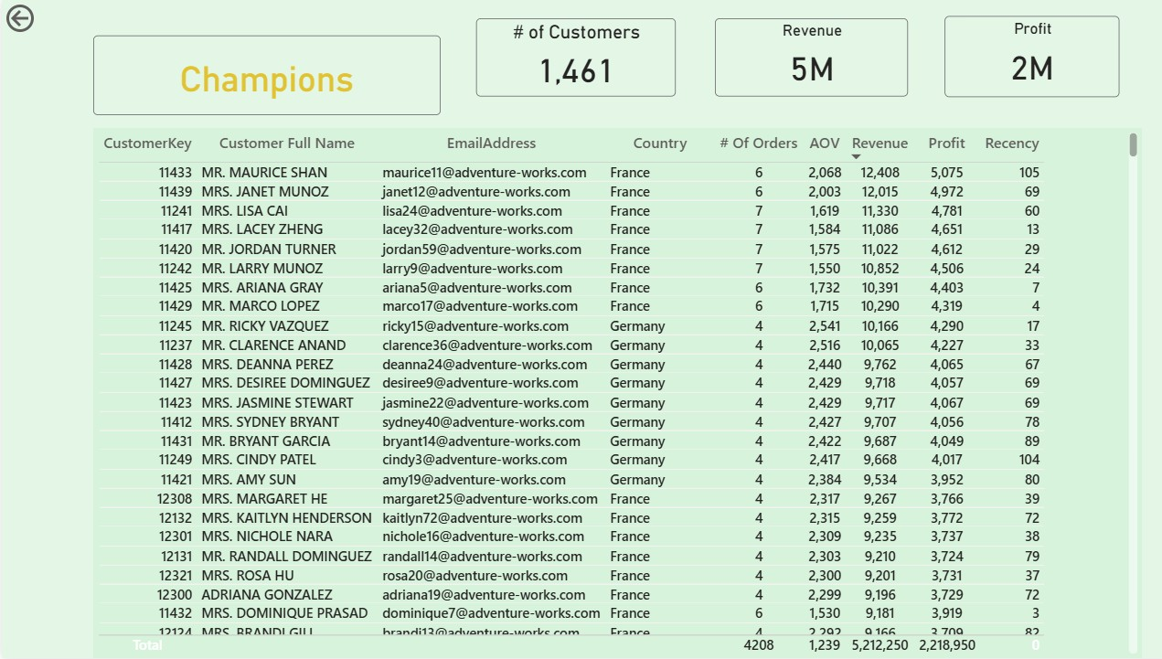
Customer Details based On Customer Segment

Slide 16
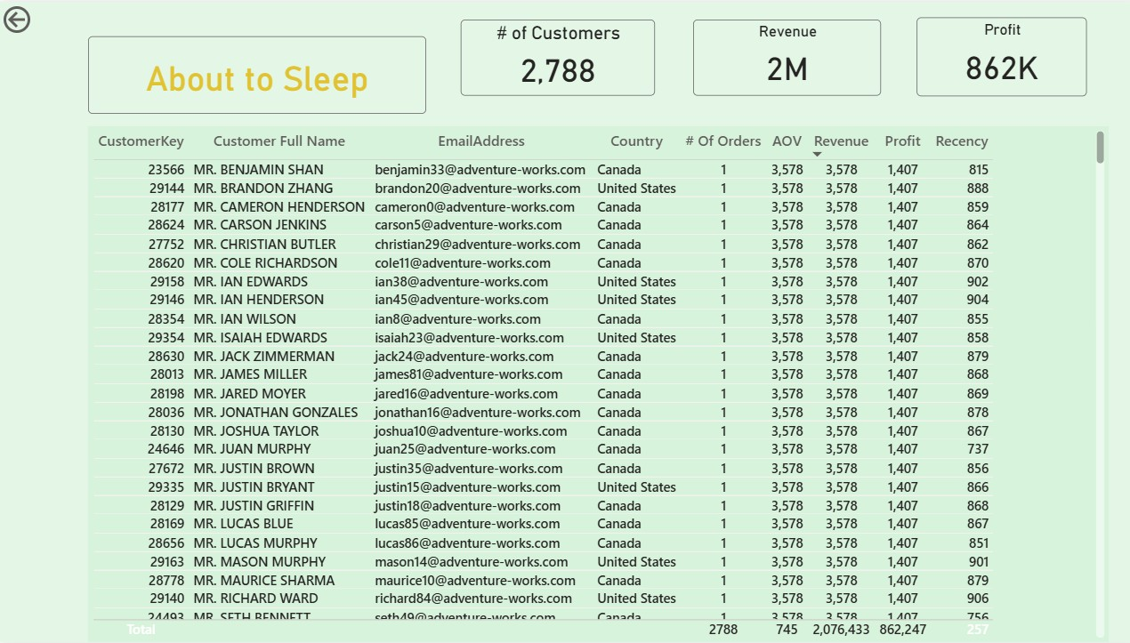
Customer Details based On Customer Segment

Slide 17
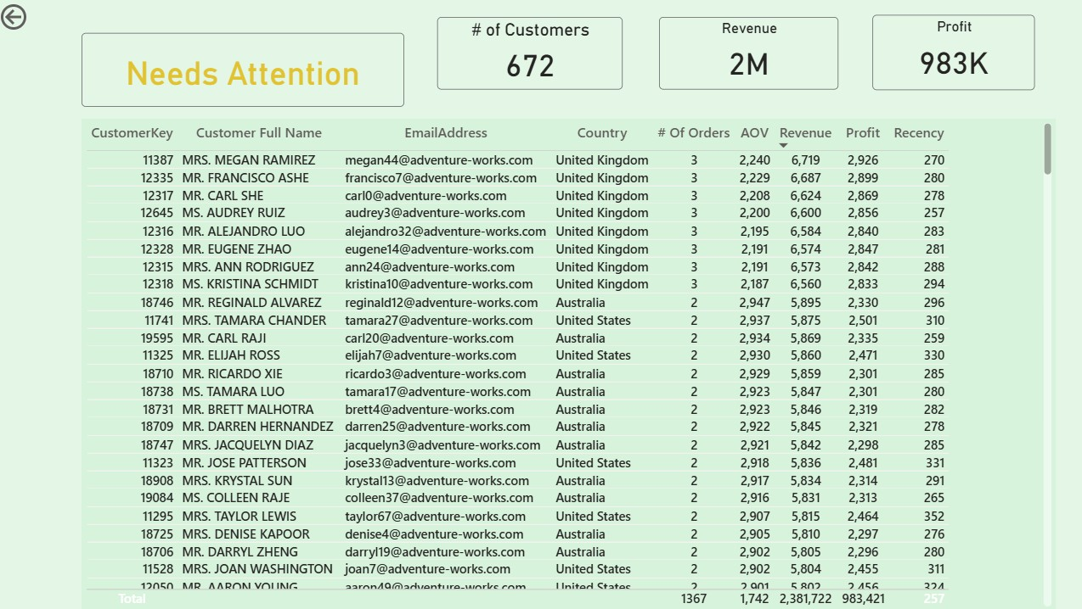
Customer Details based On Customer Segment

Slide 18
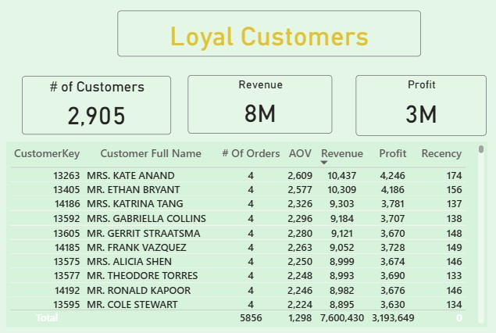
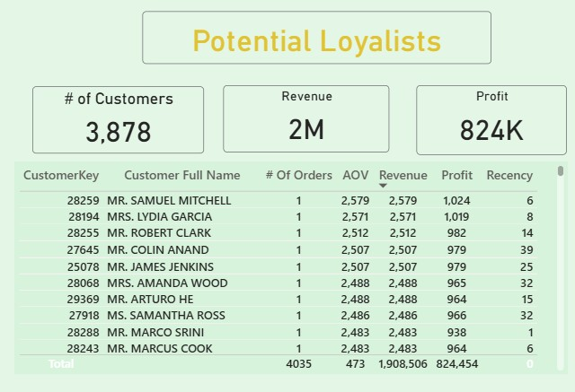
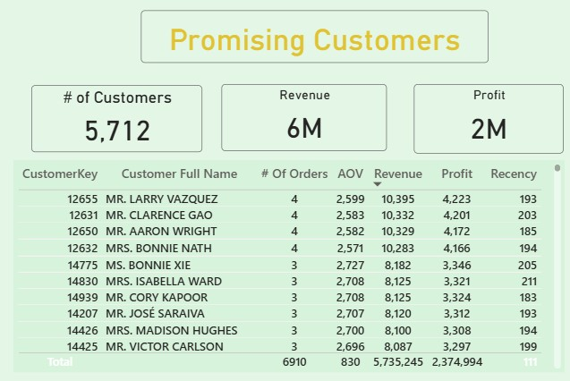

Slide 19
Observation & Insight
Champion Customers : Most of the Revenue HAS Been Generated From This Segment which is 5M Also in this segment their revenue and order also high with low recency.
Need attention : Their order count and revenue are good, but they are no longer active. With some marketing effort, they can be brought back. Otherwise, there’s a chance they might turn into churned customers. About To Sleep : These customers last made a purchase 815 or 888 days ago. They are considered churned customers.

Slide 20
Without using RFM segmentation, analyzing customer value can become misleading or one-dimensional
For example:
If we only look at the number of orders, we might think Dalton Perez is the top customer since he placed the most orders (26).
But if we look at revenue, then Maurice Sen becomes the top customer, generating the highest revenue of 12,408, even though he ordered less frequently.
This creates a problem:
Who should we focus on — the one who orders more or the one who brings more revenue?
If we consider only one metric, we might miss important insights or target the wrong segment.
That’s why RFM segmentation is so helpful.
It combines Recency (R), Frequency (F), and Monetary (M) into a single framework, allowing us to:
Compare multiple key metrics together
Understand overall customer value better
Identify who needs attention, who is most loyal, and who brings the most profit
So instead of analyzing each metric separately and facing confusion, RFM provides a balanced, data-driven way to segment and prioritize customers.

